Slide 1
Chap.6 Microscopic symmetry and space groups of crystals
Macroscopic and microscopic symmetry
Microscopic symmetry of crystals
2D space groups (plane groups)
3D space groups
Equivalent point system

Slide 2
Macroscopic and microscopic symmetry of crystals
Crystal symmetry includes macroscopic symmetry and microscopic symmetry.
The former refers to the shape symmetry of the crystals (ideal) , the later refers to the microstructure symmetry of the crystals or the symmetry of the internal structure.

Slide 3
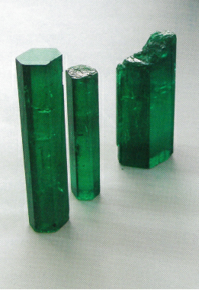

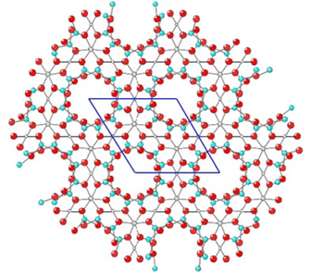
Examples
The macroscopic symmetry is the embodiment of the microscopic symmetry in the crystal shape
Snowflake
Beryl

Slide 4
Macroscopic symmetry element in crystals
Symmetry Elements | International Symbols | Symmetry Operations | Equivalent Elements /Compositions
Symmetry center | i | I | ‾1
Mirror plane | m | M | ‾2
1-fold rotation axis | 1 | L(0°)
2-fold rotation axis | 2 | L(180°)
3-fold rotation axis | 3 | L(120°) | 3+i=‾3; 3+m=‾6
4-fold rotation axis | 4 | L(90°)
6-fold rotation axis | 6 | L(60°)
4-fold inversion axis | ‾4 | L(90°) & I

Slide 5
Combination of macroscopic symmetry elements
There are eight kinds of independent macroscopic symmetry elements in crystals.
However in a crystal, there can be only one independent macroscopic symmetry element or a combined macroscopic symmetry element based on several symmetry elements according to the combination procedure and laws.

Slide 6
Combination of macroscopic symmetry elements
The combination of macroscopic symmetry elements follows two restrictions as below：
The polyhedral shape of crystals is a limited pattern, so the combination of symmetry elements must pass through a common point, namely the center of crystals.
Those symmetry elements, incompatible with the lattice structure, such as 5,7, et al., are not allowed to generated for any combinations.

Slide 7
Combination of macroscopic symmetry elements
Combination Procedures：
Combine one symmetry axis with another symmetry axis;
Then conduct the combination between symmetry axis and symmetry plane upon the first step;
Finally realize the combination of symmetry axis, symmetry plane and symmetry center.

Slide 8
Combination of macroscopic symmetry elements
According to above combination procedures and restrictions, 32 kinds of symmetric elements can be got, namely the 32 crystallographic point groups.
(There are only 32 crystallographic lattices, although the crystal shapes are diverse in nature.)

Slide 9
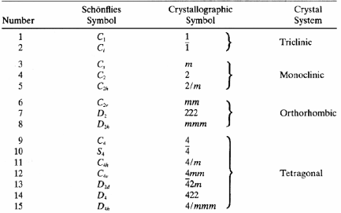
Symmetry elements of 32 crystallographic point groups

Slide 10
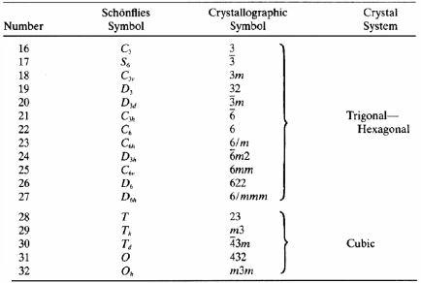
Symmetry elements of 32 crystallographic point groups

Slide 11
Characteristic symmetry elements
Among 32 point groups, some point groups contain the same symmetry elements, such as T, T_{h}, T_{d} ,O and Oh, which have four 3-fold rotation axes; The point groups of C2v, D2 and D2h all have two 2-fold rotation axes.
So the commonly contained symmetry elements are, called the characteristic symmetry elements

Slide 12
Characteristic symmetry elements
The characteristic symmetry structure can be regarded as the evidence for the classification of crystals.
Because it is very difficult to directly observe the internal microstructure of unit cells or small parallelepipeds of space lattice.
Instead, the characteristic symmetry elements, which are their reflections on the whole crystal shapes, can be directly observed.

Slide 13
Characteristic symmetry elements of seven crystal systems
Crystal System | Characteristic Symmetry Elements
Triclinic (三斜) | None or only one inversion center
Monoclinic (单斜) | One 2-fold axis or mirror plane
Orthorhombic (正交) | Three perpendicular 2-fold axes or rotary-inversion axes
Trigonal (三方) | One 3-fold axis or rotary-inversion axis
Tetragonal (四方) | One 4-fold axis or rotary-inversion axis
Hexagonal (六方) | One 6-fold axis or rotary-inversion axis
Cubic (立方) | Four 3-folds axes or rotary-inversion axes along space diagonals of unit cells

Slide 14
Classification of crystal systems and the selection of crystal axis
Crystal system | Characteristic symmetric element | Cell type | Methods of selecting crystal axis
Cubic | Four 3-folds along space diagonal | a=b=c α=β=γ=90º | 4 3-folds // 4 diagonals of cubic, 3 edges perpendicular to each other are the directions of a, b, c. intersection angle between a, b, c and 3-fold axis is 54º44’
Hexagonal | One 6-fold axis or rotary-inversion axis | a=b≠c α=β=90º γ=120º | c // 6-fold axis a, b // 2-fold axis or丄 symmetry plane choose crystal edges of a, b丄c
Tetragonal | One 4-fold axis or rotary-inversion axis | a=b≠c α=β=γ=90º | c // 4-fold axis a, b // 2-fold axis or丄 symmetry plane or crystal edges of a, b丄c

Slide 15
Classification of crystal systems and the selection of crystal axis
Crystal system | Characteristic symmetric element | Cell type | Methods of selecting crystal axis
Trigonal | One 3-fold axis or rotary-inversion axis | a=b=c α=β=γ<120º≠90º | Choose three crystal edges having equal angle with 3-folds as a, b, c.
 |  | a=b≠c α=β=90º,γ=120º | C // 3-fold axis a, b // 2-fold axis or丄 symmetry plane or choose crystal edges perpendicular to c as a, b
Orthorhombic | Three perpendicular 2-folds | a≠b≠c α=β=γ=90º | a, b, c // 2-fold axis or丄 symmetry plane
Monoclinic | One 2-fold axis or mirror plane | a≠b≠c α=γ≠β | b // 2-fold axis or丄 symmetry plane choose crystal edges perpendicular to b as a, c
Triclinic | None or only with inversion center | a≠b≠c α≠β≠γ≠90º | choose three non-coplanar crystal edges as a, b, c

Slide 16
Selection of unit cells in different
Crystal systems
Crystal system | Selection of standard unit cell | The option of unit cell selection
Triclinic | Intersect angles between crystal axes as right angle as possible , but not equal to 90° | Allow intersect angle < 90°
Monoclinic | Y axis // one 2-fold axis or丄 mirror plane，β angle nearly close to 90° | Selection as the same standard, but substitute Z axis with Y axis, substitute g angle with b angle
Orthorhombic | crystal axis // Three perpendicular 2-folds or丄 mirror plane | None
Tetragonal | Z axis // one 4-fold Rotation(inversion) axis, X axis丄 Y axis丄 Z axis | None
Trigonal | Z axis // one 3/6-fold rotation(inversion) axis, both X axis and Y axis丄 Z axis, intersect angle between X axis and Y axis is 120 ° | In Trigonal system, 3-fold axis is selected as the diagonal of primitive cell, then a=b=c, a=b=g≠ 90°
Cubic | crystal axis // Three perpendicular 2-folds or 4-folds, four 3-folds // body diagonal of cubic cell | None

Slide 17
Significance of the point groups
No matter how complicated the shapes and diversities of crystals are, their microscopic symmetry must belong to one of 32 point groups.
32 point groups are the basis for studying the macroscopic symmetry, and it is the systematic summary of the macroscopic symmetry of crystals.

Slide 18
Point groups and physical properties
According to the symmetry of point groups, whether certain crystals have some physical properties, such as enantiomer （对映体）, optical rotation（旋光性）, piezoelectric effect（压电效应）, thermoelectric effect（热电效应）, frequency-doubled effect （倍频效应）and so on, can be determined.
Optical rotation appears in 15 point groups without symmetric centers.
Thermoelectricity exists in 10 point groups only containing one polar axis.
Piezoelectricity appears in 20 point groups without symmetry centers (except 432).
The frequency-doubled effect appears in 18 point groups without symmetric centers.
On the contrary, the measurement of the physical properties towards the crystal structure, can also determine whether the crystal has a symmetrical center.

Slide 19
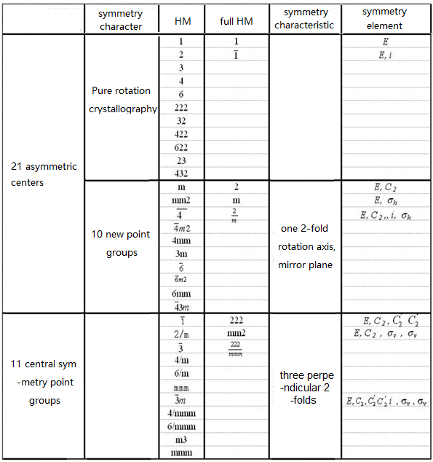
Point groups and physical properties
11 pure rotation point groups
21 non centro-symmetric
point groups
10 new
point groups
11 centro symmetric point groups

Slide 20
Microscopic symmetry of crystals
Microscopic Symmetry and Symmetry Operation of Crystals
The most basic characteristic of a crystal structure is the spatial lattice structure. Therefore, besides the operations of rotation, reflection, inversion and rotation reflection, crystal structure also includes three types of translation-related symmetric operations.
Symmetry Elements：
Symmetry Operations：
Translation Axis
Screw Axis
Glide Plane
Translation Operation
Screw Rotation Operation
Glide Reflection Operation
Since the microscopic symmetry operation of crystals is restricted by the lattice structure, the screw axis only have 1,2,3,4,6-fold axis; the slippage (滑移量）for slip plane and screw axis is also restricted by lattice structure.

Slide 21
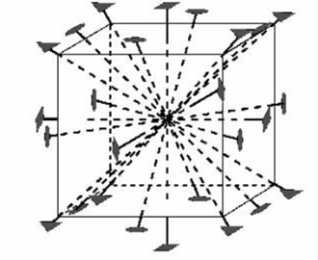
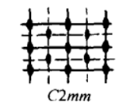
Microscopic symmetry of crystals
Microscopic Symmetry Operation ＝
Macroscopic Symmetry Operation + Glide Operation;
Differences between Microscopic Symmetry and Macroscopic Symmetry:
Macroscopic symmetry elements must intersect at certain point. Symmetry elements in microscopic symmetry don’t need to intersect at one point, and can infinitely distribute in 3D space.
Only direction of symmetry elements in macroscopic symmetry should be considered while the relative position of symmetric elements in microscopic symmetry also need to be considered.

Slide 22
Microscopic symmetry elements of crystals
Translation axis
A direction along one straight line, the corresponding operation is to move a certain distance along the direction.
For a pattern with translation axes, the same parts of the pattern can be repeated when the above-described symmetry operation is performed.
The minimum translation distance in symmetric transformation, which enables a pattern to be restored, is called the travel distance (移距) of the translation axis.

Slide 23
Lattice and translation operation
Crystal lattice（点阵）reflects the periodicity of crystal structure, which is the characteristic of crystals to translate and restore.
Translation operation allows lattice to be restored, namely the same parts of crystal structures, infinitely stretching in 3D space, can be repeated.
For lattice, a position vector connecting two arbitrary lattice points is expressed as:
R = ma + nb + pc
R Translation vector of microstructure translation operation

Slide 24
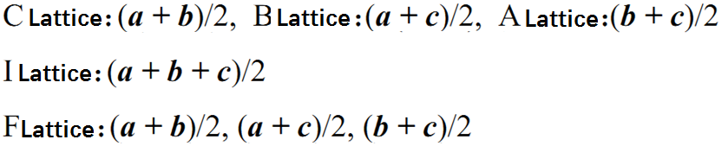
Translation vector
14 kinds of space lattices reflect the combination rules of translation symmetry in crystal structure. Each space lattice has a basic translation vector a, b, c and a+b, a+c, b+c, a+b+c, and so on.
In addition, there are additional translation vectors for the complex lattices:

Slide 25
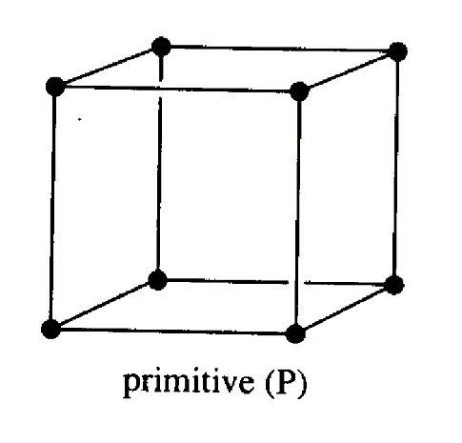
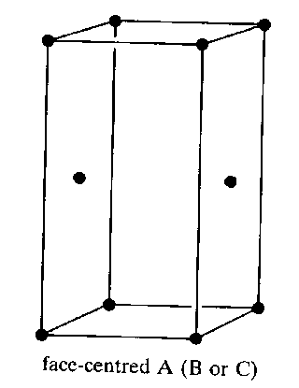
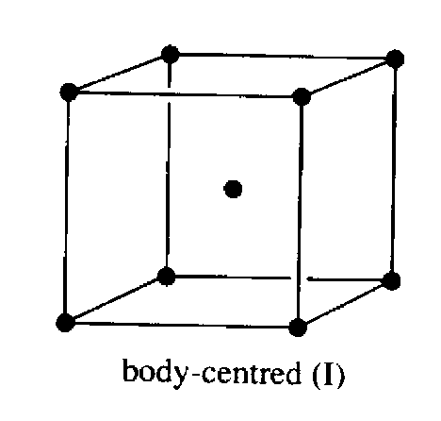

Additional translation vector in complex lattice
Base-Centered Lattice(C):
Additional lattice point at [[½ ½ 0]]
Body-Centered Lattice(I):
Additional lattice point at [[½ ½ ½]]
Face-Centered Lattice(F):
Additional lattice point at [[0 ½ ½]], [[½ 0 ½]] and [[½ ½ 0]].

Slide 26
Microscopic symmetry elements of crystals
Screw axis
A combined symmetry element; its auxiliary geometric elements： a hypothetical straight line (axis) and the direction parallel to the line.
The corresponding symmetry operation is screw rotation operation: around one straight line to rotate a certain angle, then along the straight line each particle will overlap with one same particle after translating a certain distance, which is known as the combined operation of rotation and translation.

Slide 27
Microscopic symmetry elements of crystals
Screw axis
n_{s}, international symbol of screw axis
n, order of axis,
s, natural number less than n.
n, determine rotation angle (360 °/ n) for each rotation
n and s determine translation distance.

Slide 28
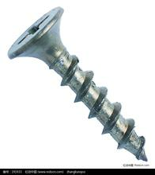
If lattice point spacing in the direction of screw axis is marked as t, the translation distance or thread pitch（螺距） is given byτ= (s / n) t, where t is the unit vector paralleled to the translation vector.
According to axis order and thread pitch, screw axes can be classified as
2₁ 3₁、3₂ 4₁、4₂、4₃ 6_{l}、6₂、6₃、6₄、6₅
n_{s} is the international symbol of screw axis which is based on the right-hand system.

Slide 29
What does n_{s} mean respectively?
Examples：
4₁ -translation distance is (1/4)·t after rotating 90 degree along the direction of counter-clockwise
4₃ -translation distance is (3/4)·t after rotating 90 degree along the direction of counter-clockwise

Slide 30
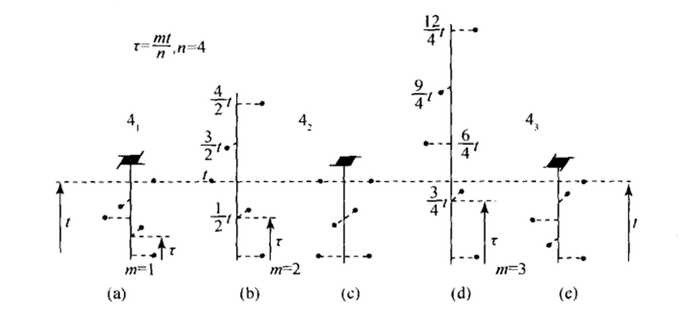
4₃
4₂
4_{１}
Combined symmetry operations of 4-fold screw axes
4₁ ;
4₂ 2t translation after 4 times’ rotation of 90 degrees;
4₂ sketch map after translation equivalence of lattice points;
4₃ 3t translation after 4 times’ rotation of 90 degrees;
4₃ sketch map after translation equivalence of lattice points.
Notes:
Ns, s为偶数的时候，由于平移的不变性，结构上的点都是成对出现。

Slide 31
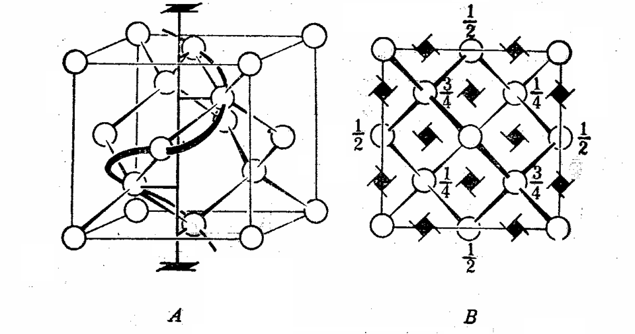
Examples
4₁ and 4₃ in Diamond crystal structure.
A gives the 4₁ and B gives the projection and screw axis distribution
Notes:
右图的数字是z方向的位置，如1/4代表离地面1/4周期

Slide 32
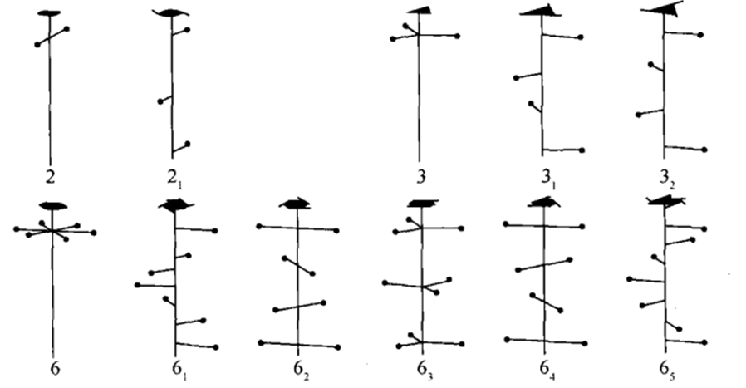
Schematic diagram of 2, 3 and 6-fold screw axis after translation equivalence.
Question：Try to explain why symmetry points in the schematic diagram of 6₃ must appear in 3-fold symmetry?

Slide 33
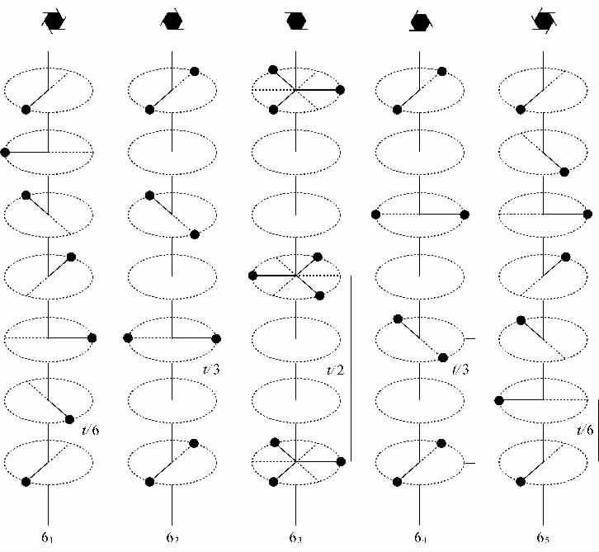
6-fold screw axis of 6₁, 6₂, 6₃, 6₄ and 6₅.
Any problems?
Notes:
６２是旋转６０°然后在平移1/3 t单位；6 4 旋转６０°然后在平移2/3 t单位；图7-4 不仅第二个图和第四个图应该调换，而且虚线和实线也对应错误。

Slide 34
Microscopic symmetry elements of crystals
Screw axis
Another way for the symmetry operation
Regulations：
When 0<s<n/2, the screw axis is right-handed rotation(including 3₁ , 4₁ , 6₁ , 6₂), screw pitch is（s/n）·t；
When n/2<s<n, the screw axis is left-handed rotation(including 3₂ , 4₃ , 6₄ , 6₅), screw pitch is（1-s/n）·t；
When s=n/2, the screw axis is neutral (including 2₁ , 4₂ , 6₃), screw pitch is (1/2)·t.
To get all the symmetry points in a short distance

Slide 35
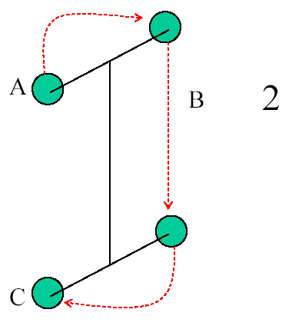
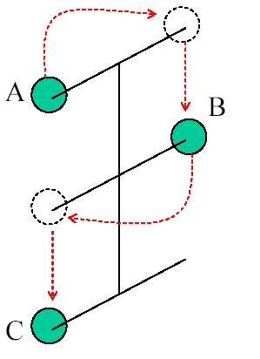
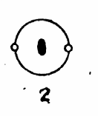

Twofold Screw Axis
Schematic diagrams of operations and polar projections
t/2
2
2₁
t

Slide 36
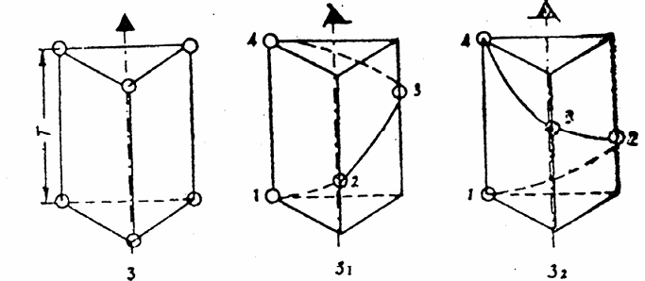
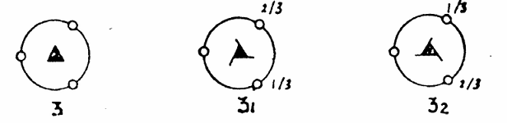
Screw axis 3₁ and 3₂
Schematic diagrams of operations and polar projections
31 and 32 are opposite to each other. If one is right-handed rotation, another one will be left-handed rotation.

Slide 37
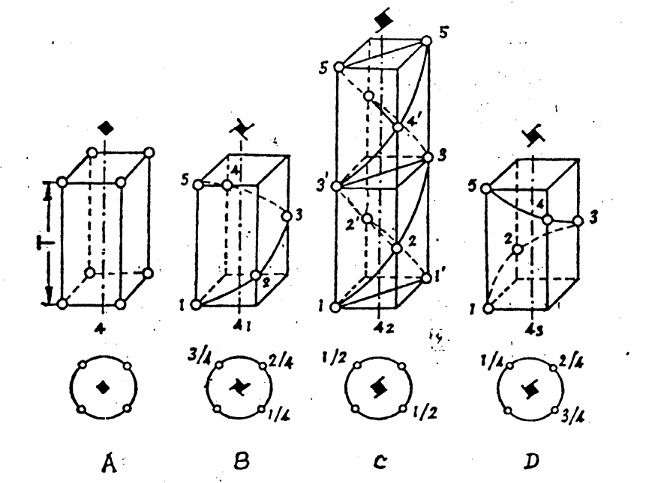
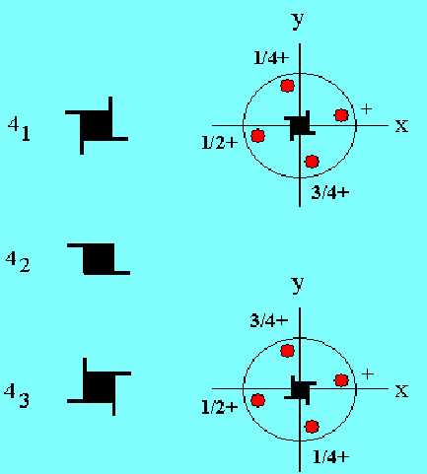
Screw Axis of 4₁，4₂ ，4₃
Schematic diagrams of operations and polar projections
+ indicates the outward direction of the paper
4₁ and 4₃ are opposite to each other. If one is right-handed rotation, another one will be left-handed rotation

Slide 38
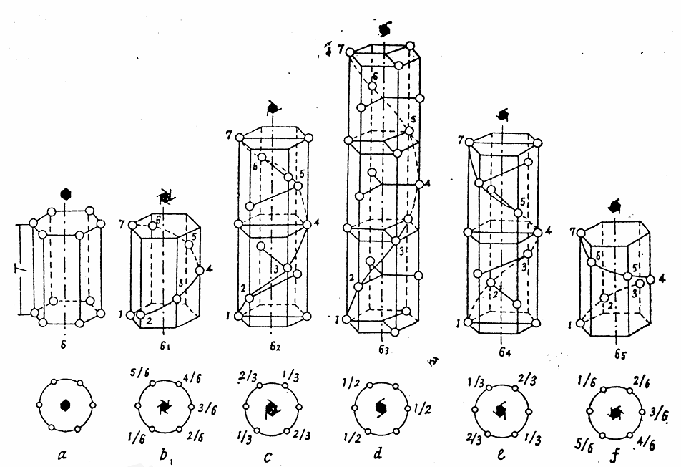
Screw Axis of 6₁，6₂，6₃，6_{4,}

Slide 39
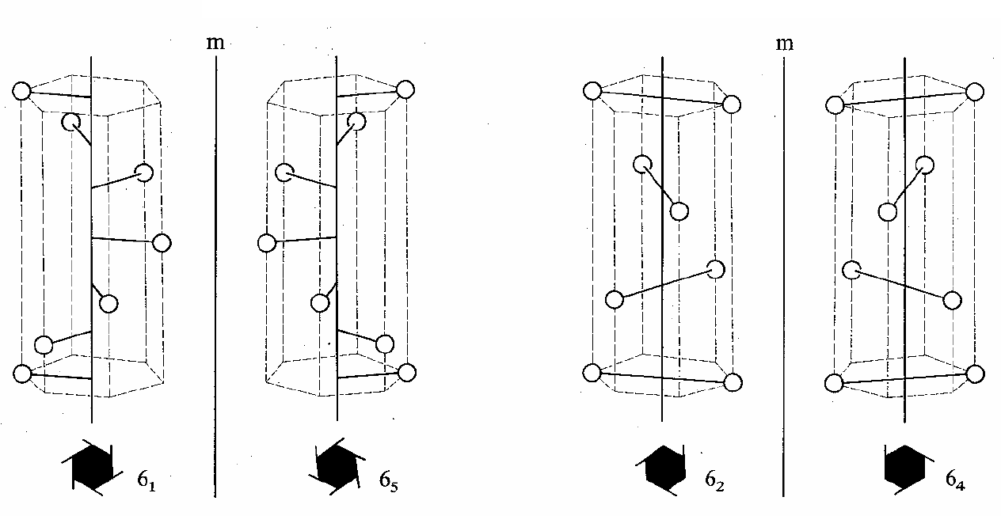
Schematic diagrams of operations and polar projections
6₁ and 6₅ , 6₂ and 6₄ are opposite to each other. If one is right-handed rotation, another one will be left-handed rotation

Slide 40
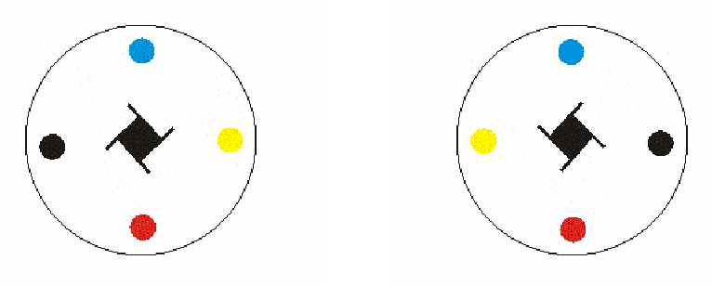

Unlike the rotation axis, different rotation directions of screw axis result in different symmetrical structures. Such as the structures, gained by the rotation axis of the left-handed 4₁ and right-handed 4₁, are different which are known as the enantiomers

Slide 41
Microscopic symmetry elements of crystals
Glide plane:
It is a combined symmetry element, which is also called the glide reflection plane （反映面）and image shifting plane（像移面）.
Auxiliary geometric elements: a hypothetical plane and a straight line parallel to this plane.
Symmetry operation: reflection to the hypothetical plane and the translation along this straight line. its translation distance equals to half of the node spacing along this line (basic translation vector)
Notes:
auxiliary
英 /ɔːɡˈzɪliəri/

Slide 42
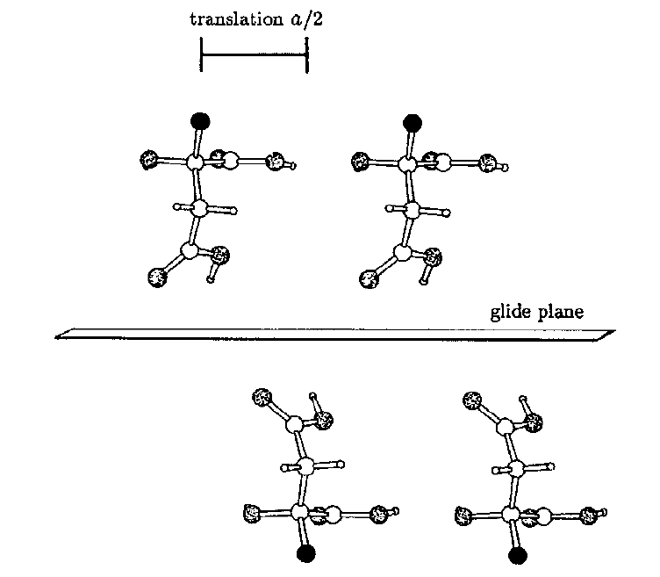

The glide reflection operation is the combined operation of reflection and translation
The glide reflection operation changes the chirality of the asymmetric unit
Mini project： Introduction of chirality?

Slide 43
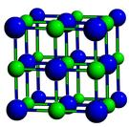
According to glide direction and distance, glide plane can be classified into 5 kinds: a, b, c, n, d.
a/2
a, b, c are axial glide, the glide distance is ½ a, ½ b, ½ c.
n is diagonal glide, the glide distance is ½(a+b), ½(b+c)，½ (a+c), ½(a+b+c).
d is diamond glide, the glide distance is ¼(a+b)，¼ (b+c), ¼ (a+c), ¼(a+b+c).
Exercise：find crystal structures that has n and d and show these glides.

Slide 44
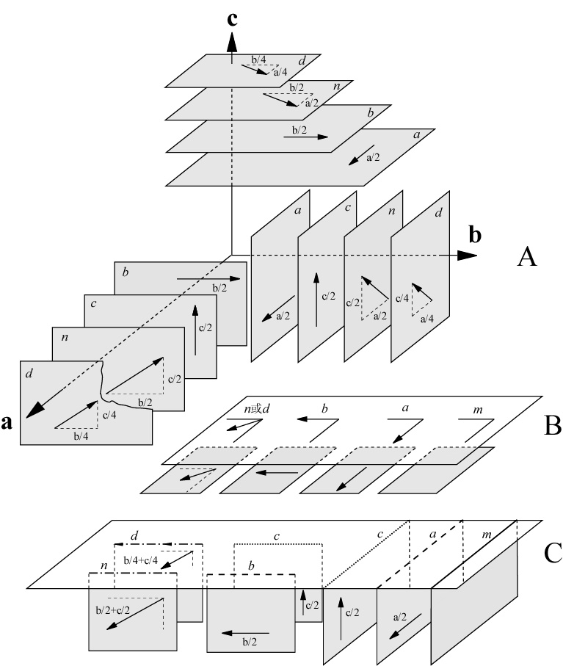
Microscopic Symmetry Elements of Crystals
Glide plane (a、b、c、n、d )
A. Glide vector distribution of various glide planes along coordinate axes.
B. Illustrate marks of glide plane paralleled to projection plane
C. Illustrate marks of glide plane vertical to projection plane
Notes:
其他不垂直和平行于坐标轴的镜面是否存在？我想应该是有的。

Slide 45
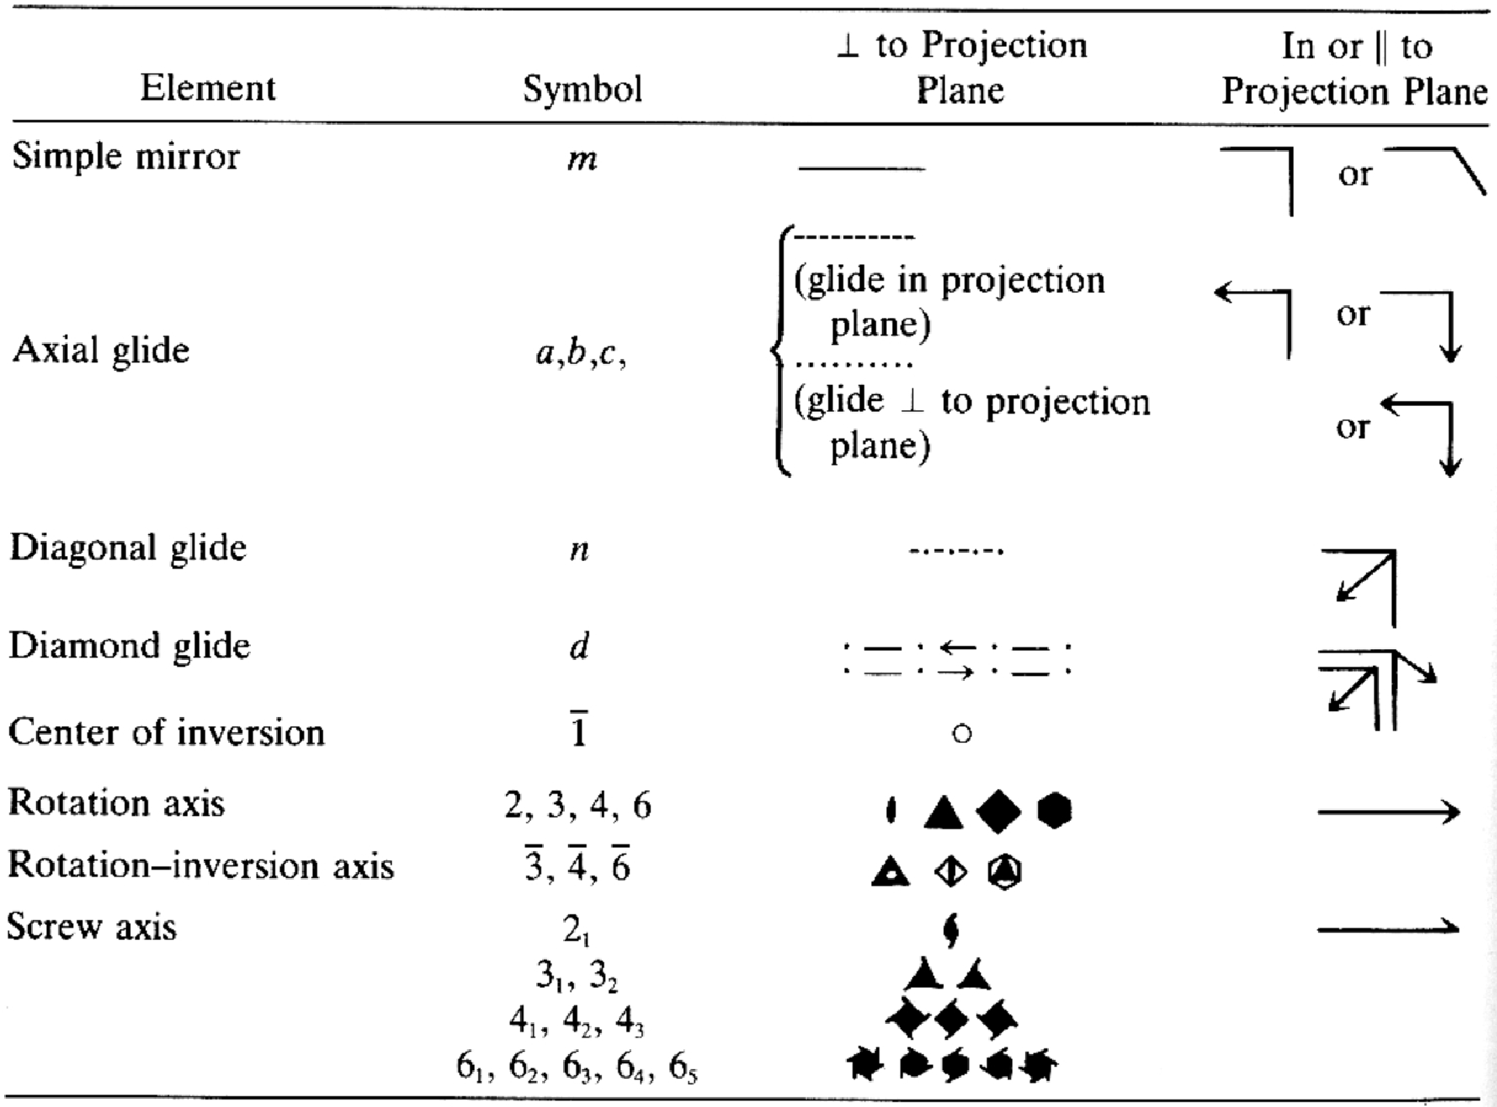
Symmetry elements and symbols

Slide 46
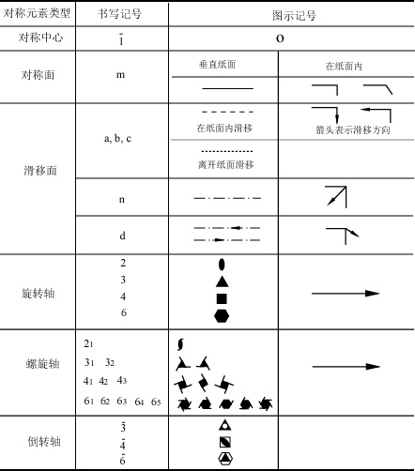
晶体中可能的对称元素及其符号
在纸面内或者平行于纸面滑移
两条成90度角的线段代表滑移面和纸面平行或者重合

Slide 47
Space Groups
Macroscopic symmetry of crystal(shape symmetry)
Symmetry elements：symmetry axis, symmetry plane and symmetry point
The collection of macroscopic symmetry elements is also called point group.
Microscopic symmetry of crystal(inner symmetry）
Symmetry elements： Besides macroscopic symmetry elements, there are microscopic symmetry elements containing translation operations, such as translation axes, glide plane, screw axes, etc.
Space lattice (translation groups) + Point groups → Space groups

Slide 48
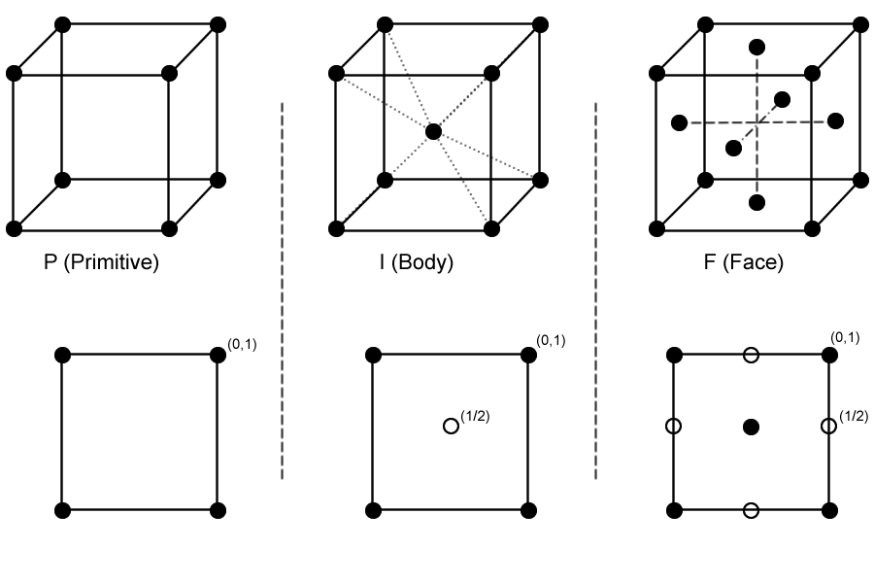
2D Groups (plane groups)
The set of all symmetry elements in plane, which can be regarded as the projection of 3D space groups on 2D plane.

Slide 49
HRTEM images of certain axial directions in silicon crystals
[100]
[110]
[111]
[112]
Exercise: please find the HRTEM images taken along above directions to see 2D patterns formed from the projections of 3D crystal structures.

Slide 50
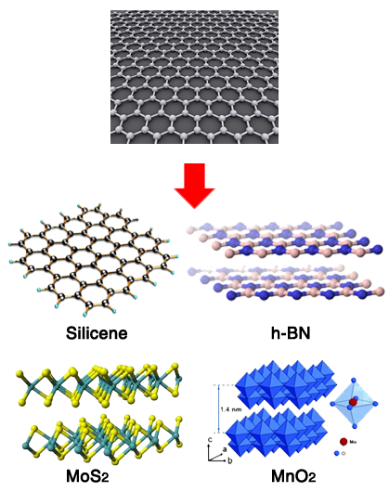
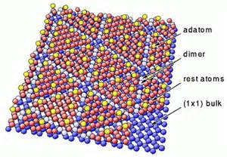
2D groups (plane groups)
Si 7*7（111）
https://vimeo.com/1086112
Two - dimensional nanocrystals
Reconstruction of crystal
Notes:
Surface reconstruction refers to the process by which atoms at the surface of a crystal assume a different structure than that of the bulk.
Closest packing

Slide 51
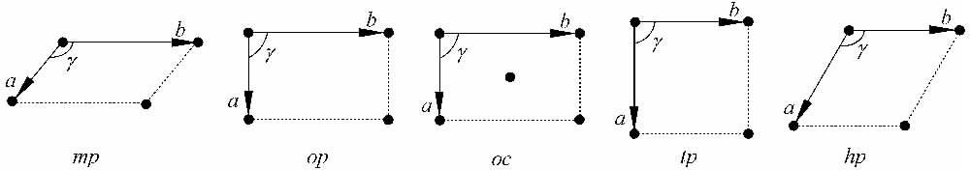
Five bravais lattices for 2D patterns
Monoclinic m
Orthorhombic o
Tetragonal t
Hexagonal h
Six basic symmetry elements for 2D patterns
1, 2, 3, 4, 6 and m

Slide 52
Characteristic
Crystal system
Symmetry elements
Point groups
Unit cell parameters
Brava cells
Monoclinic m
Only 1 or 2
1, 2
a ≠ b, γ ≠ 90°
mp
Orthorhombic o
m
1m, 2mm
a ≠ b, γ = 90°
op,oc
Tetragonal t
4
4, 4mm
a = b, γ = 90°
tp
Hexagonal h
3 or 6
3, 3m, 6, 6mm
a = b, γ = 120°
hp
4 crystal systems, 5 Brava cells/unit cells；
6 symmetry elements, namely 1,2,3,4,6 and m；
10 2D plane point group, namely 1,2,3,4,6, 1m,2mm,3m,4mm,6mm;
2D microcosmic symmetry elements?
g & translation groups

Slide 53
The representation of 2D point groups
For example:
6mm
Symmetry elements perpendicular to projection plane
1
3
Symmetry elements from up to down(x)
2
Symmetry elements from left to right(y)
Note: the 1, 2, 3 positions indicate different directions, which can refer to the forth slide in the following.

Slide 54
Ten symmetry elements of 2D pattern and their stereographic projections
Exercise：try to draw the stereographic projection of 4, 4mm, 3m.

Slide 55
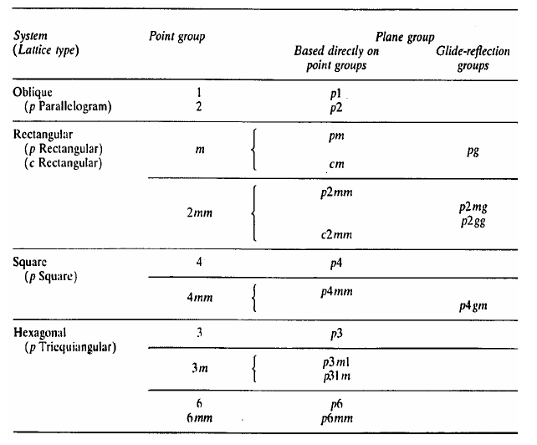
2D space groups - 17 plane groups
Space lattice(translation groups) + Point groups → Space groups；What’s the compatibility of symmetry element and lattice?
Notes:
2 次及4次对称的格子中m可以转化成g； cm→cg?
Space lattice(translation groups)+ Point groups → Space groups；What’s the compatibility of symmetry element and lattice?
格子要和点群也就是宏观对称性保持一致，所以点群在和格子结合的时候，是有选择性的。

Slide 56
2D space groups - 17 plane groups
Crystal system
and lattice
Point group symbol
National symbol of plane groups
Space group number
Full
Abbr
Oblique (Monoclinic)
p
1
p1
p1
1
2
p211
p2
2
Rectangular
(Orthogonal)
p, c
m
p1m1
pm
3
p1g1
Pg
4
c1m1
cm
5
2mm
p2mm
pmm
6
p2mg
pmg
7
p2gg
pgg
8
c2mm
cmm
9
Square (Tetragonal)
p
4
p4
p4
10
4mm
p4mm
p4m
11
p4gm
p4g
12
Hexagonal
p
3
p3
p3
13
3m
p3m1
p3m1
14
p31m
p31m
15
6
p6
p6
16
6mm
p6mm
p6m
17
Notes:
2 次及4次对称的格子中m可以转化成g； cm→cg?
Space lattice(translation groups)+ Point groups → Space groups；What’s the compatibility of symmetry element and lattice?

Slide 57
The representation of 2D space groups
For example: No. 7 2D space group
p2mg
The direction perpendicular to the paper plane
Lattice type
point group
Crystal system
The indicating directions of 3 positions(listed in turn)
1
2
3
1
2
3
isometric
c
a+b+c
a+b
[001]
[111]
[110]
tetragonal
c
a
a+b
[001]
[100]
[110]
orthorhombic
a
b
c
[100]
[010]
[001]
monoclinic
b
[010]
triclinic
Arbitrary direction
Arbitrary direction
hexagonal
c
a
2a+b
[001]
[100]
[210]

Slide 58
The representation of 2D space groups
For example: No. 7 2D space group
p2mg
Lattice type
1
Symmetry elements to projection plane
Symmetry elements from up to down(x)
3
2
Symmetry elements from left to right(y)
First to determine lattice type according to the space group, then to determine the corresponding direction of 1-3 positions according to the comparison table.

Slide 59
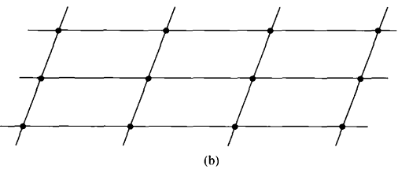

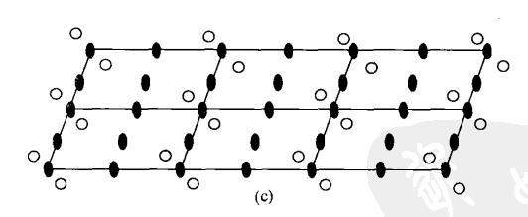
Example - P2
Notes:
二次旋转点对称要素配置到网格格点上；
进行平移对称操作的结果使得网格的每个结点均配置了2次旋转点。

Slide 60
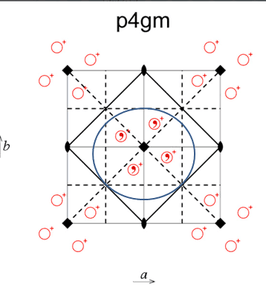

Example – P4gm
m
g
P4 gm
Notes:
comma
英 /ˈkɒmə/ 逗号；
chirality
英 /kaɪˈrælɪtɪ/ 手性；
对称元素的相对位置非常重要，不同的位置对应的空间群不一样

Slide 61
2D space groups - 17 patterns for plane groups
m

Slide 62
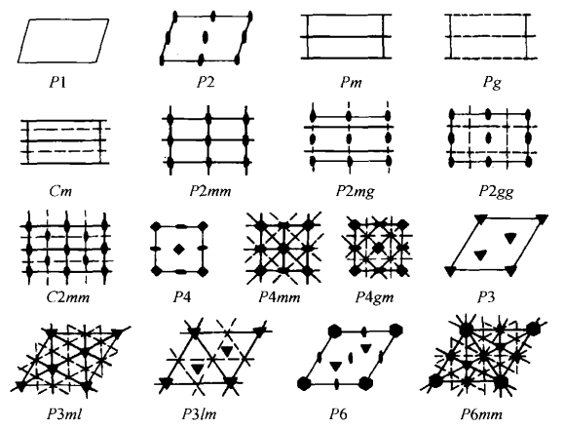
Distribution of symmetry elements in 17 plane groups
Thick lines (connecting line of lattice are thin solid lines) and dotted lines, represent mirror and glide plane respectively, whose orientation are vertical to the paper plane.

Slide 63
Representation of 2D space groups
Exercise: Please give the general equivalent points and the distribution of symmetry elements in the following 2D space groups:
P2mm; P2mg; P2gg ?
Notes:
P2mm; P2mg; P2gg 实际上我也不知道前两个m应该一开始在哪里，晶胞轴上？或者中间1/2处？或者1/4处

Slide 64
Representation of 2D space groups
P2mm; P2mg; P2gg ?
P2
m? g?

Slide 65
Representation of 2D space groups
P2mm; P2mg; P2gg ?
P2
m? g?

Slide 66
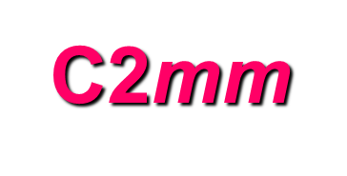
Representation of 2D space groups
Exercise: Please give the general equivalent points and the distribution of symmetry elements in 2D space groups No. 9 2D space group
Notes:
P2mm; P2mg; P2gg 实际上我也不知道前两个m应该一开始在哪里，晶胞轴上？或者中间1/2处？或者1/4处

Slide 67
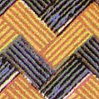
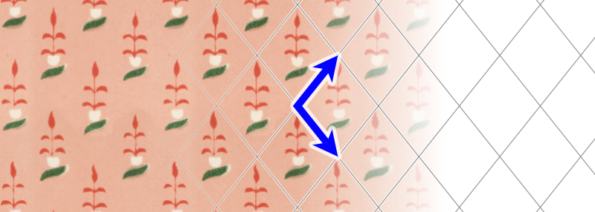
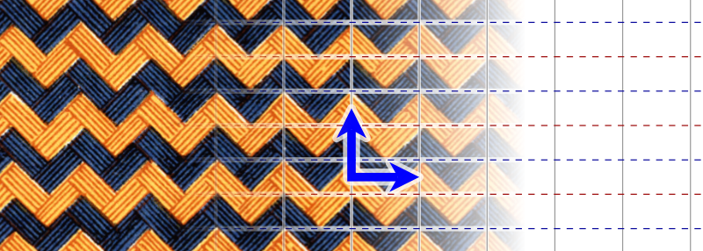

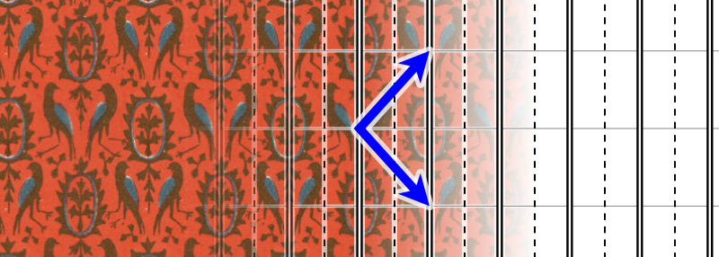
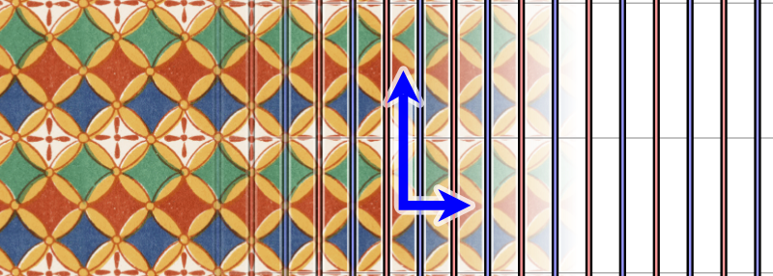
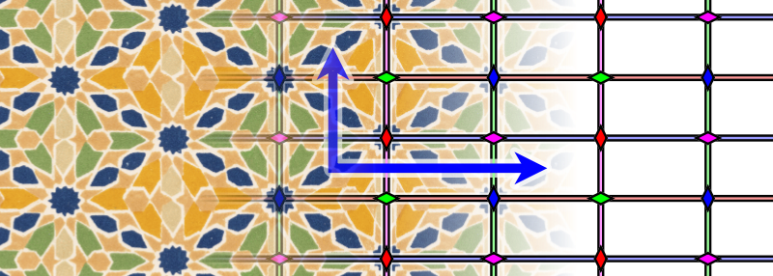
Exercises: marking space groups
Notes:
https://en.wikipedia.org/wiki/Wallpaper_group answers

Slide 68

Exercises: marking space groups
P1
p1g1
C1？no this point group
Only cm，but there is no m here.
c1m1
P211 or P4（×）
P1m1 or P2mm（×）
these two points are not equivalent
P2mm or C2mm （×）
Notes:
https://en.wikipedia.org/wiki/Wallpaper_group answers
P211 中蓝色的格子中白条没有4次对称；P1m1中蓝绿格子不对称，没有m。
没有C1的原因是因为我们格子的对称性要和宏观对称性保持一致

Slide 69
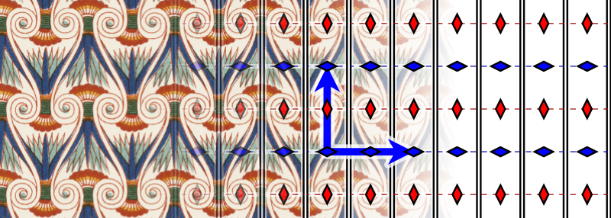
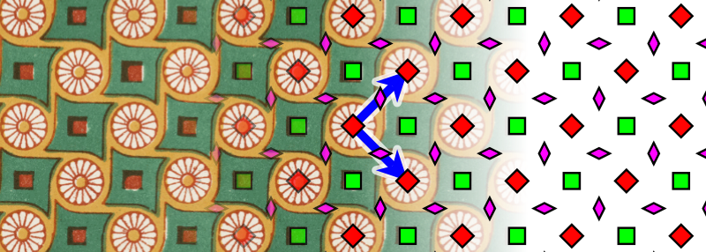
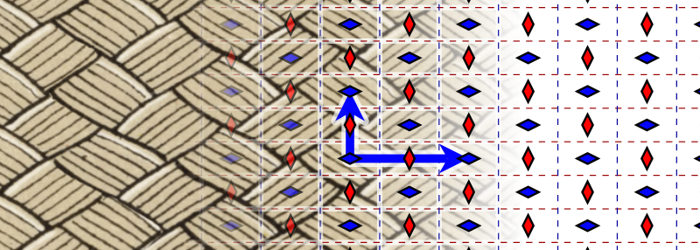



Exercises: marking space groups
Notes:
先找点阵（格子），再找旋转对称性最高的位置，然后看m和g

Slide 70


Exercises: marking space groups
p2mg
p4
p2gg
p4mm
c2mm
p4gm
Notes:
为啥不是p4mg；龟腚啊，其实换个坐标轴旋转90°就好了; P4mm 里面有g的，还是要看方向。。。同一个方向是可以既有m又有g，但是重合的方向不可以。P4mm为什么不是P4mg，简单起见。

Slide 71
Exercises: marking space groups
p2mg
p4
p2gg
p4mm
c2mm
p4gm
Notes:
为啥不是p4mg；龟腚啊，其实换个坐标轴旋转90°就好了; P4mm 里面有g的，还是要看方向。。。同一个方向是可以既有m又有g，但是重合的方向不可以。P4mm为什么不是P4mg，简单起见。

Slide 72





Exercises: marking space groups

Slide 73
Exercises: marking space groups
p3
p6
p3m1
p6mm
p31m

Slide 74


Representation of 2D space groups –
equivalent point system
Equivalent point system is a set of positions that are associated by symmetric elements in 2D space group
For example: No. 7 2D space group
Coordinates of general equivalent points：x, y；- x, - y；1/2 - x, y; 1/2+x, -y ；x, y<1 and x, y are positive number；
Y
(x, y)
X
General equivalent points and the distribution of symmetry elements of 2D space groups- P2mg
Notes:
从空间群找对等点的过程，就是一个从空间群到晶体结构的过程。

Slide 75
3D space group
The combination of all symmetry elements in crystal internal structures.
A space group composes of two parts. One is translation group, which contains all of the translation axis; another is point group, the group of macroscopic symmetry elements in crystals.
Space group is derived from point group(Symmetrical type). One point group can produce a lot of space group. All 32 point groups can produce 230 kinds of space groups.
The representation symbol of space group is consistent with the point group. International Symbols and Schfl Symbols.

Slide 76
The relationship of macroscopic symmetry and microscopic symmetry
When translation is combined with macroscopic symmetry in microscopic crystal structure, different kinds of microscopic symmetry elements appear.
Macro
Translation
Micro
Reflection plane
glide plane
Reflection plane
Rotation axis
screw axis
Rotation axis

Slide 77
Isomorphic space group(同形空间群)
Different microscopic symmetry elements can be derived from the same macroscopic symmetry elements. Thus, while some crystals belong to the same point group, they may belong to different space groups.
And all these space groups containing the same macroscopic symmetry are called isomorphic space groups of this point group (corresponding to the macroscopic symmetry).
e g: All of the isomorphic space groups of C_{2h} : P2/m, P2₁/m, P2₁/c, C2/m, C2/c.
C_{2h} → Point group 2/m

Slide 78
The derivation of space group
1. symmorphic space group （点式空间群）
Obtained from the combination of 14 bravais lattices and 32 point groups.
eg
Monoclinic crystal system
Point group: 2(C₂), m(C_{s}), 2/m(C_{2h})
Space group: P2, Pm, P2/m, C2, Cm, C2/m
Monoclinic mP
Monoclinic mC
(There are 73 kinds of point space groups in 7 crystal systems)

Slide 79
The derivation of space group
2. Non-symmorphic space group （非点式空间群）
Based on symmorphic space group, replace the rotation axis and mirrors by isomorphic symmetry element (同形对称元素）one by one (rotation axis→screw axis, mirror→glide plane). Remove the impossible combinations and merge the same combinations.
eg
2/m （C_{2h}）point group in Monoclinic system
Possible symmetry elements: 2(twofold rotation axis), 2₁(twofold scrow axis:‘2 sub 1’), m(simple mirror), c(glide plane).
Possible lattice: P, C.
Possible space group：P2/m, P2₁/m, P2/c, P2₁/c,
C2/m, C2₁/m, C2/c, C2₁/c。
(There are 157 non-symmorphic space groups in 7 crystal systems)

Slide 80

The 230 3-Dimensional Space Groups

Slide 81

The 230 3-Dimensional Space Groups

Slide 82

The 230 3-Dimensional Space Groups

Slide 83

The 230 3-Dimensional Space Groups

Slide 84

The 230 3-Dimensional Space Groups

Slide 85
Type and distribution of 230 space groups
Triclinic : 2; monoclinic : 13; orthorhombic : 59;
trigonal : 25; tetragonal : 68; hexagonal : 27;
Cubic : 36
90 with symmetry center, 140 without symmetry center (including 65 Chiral groups)
73 symmorphic space groups, 157 non- symmorphic space groups

Slide 86

Equivalent point system
1. Definition: According to symmetry requirements of space groups, wherever there is an atom in one certain coordinate point in a unit cell, the other coordinate points must have the same atoms. These equivalent points, symmetric to each other, are called equivalent point system.
General equivalent point system (A) (table 7-6 in textbook) and projection of symmetry element（B）of space group Pnma

Slide 87
2 fold rotation
Inversion
translating 1/2 unit perpendicular to paper plane
+
+
+
Notes:
comma
英 /ˈkɒmə/ 美 /ˈkɑːmə/ 逗号

Slide 88
1/4
Parallel to projection plane with a distance of 1/4 unit
Reference plane
with a distance of 1/2 unit to the projection plane
Translate 1/2 unit
mirror image
Axial glide plane
with a distance of 1/4 unit to the projection plane
Projection plane

Slide 89
1/4
Parallel to projection plane with a distance of 1/4 unit
Reference plane
with a distance of 1/2 unit to the projection plane
Translate 1/2 unit
mirror image
Axial glide plane
with a distance of 1/4 unit to the projection plane
Projection plane

Slide 90
Equivalent points are created by symmetry operations with the same color
+
+
+
+
Pnma general equivalent point system(A) and projection of symmetry elements(B)
1/4
Please refer to table 7-1 and figure 7-6 in text book.
axial slip
Parallel to projection plane with a distance of 1/4 unit
inversion( change chirality)
m mirror ( perpendicular to projection plane, change chirality)
2₁ screw axis
n diagonal glide plane (perpendicular to the projection plane) (read figure 7-6 in text book)
Screw axis ( in projection plane)

Slide 91
2. Wyckoff position
(1) Wyckoff position: equivalent point system, one of the most useful information, is expressed as Wyckoff position in the table of international space group.
Wyckoff position can tell us where one can find atoms in crystals.
A space group has one set of points with general positions and several sets of points with special positions.

Slide 92
(2) Explanation of Wyckoff position
Multiplicity(多重性）: Tells us how many atoms will be generated if all the symmetrical operations of one space group are performed on a position, if a particular atom is placed in that position.
Letter（记号）: Marking from high symmetry position in alphabetical order （按字母顺序） of a, b, …
Symmetry（对称）: tell us symmetry elements in the position of atoms.
Example: Wyckoff position of pm ( another example in page 92 in textbook)
Multiplicity | Wyckoff letter | Point symmetry | Coordinate
2 | c | 1 | x， y， z (2) x， - y， z
1 | b | m | x， ½， z
1 | a | m | x， 0， z

Slide 93

For the description of crystal structures, the multiplicity and Wyckoff letter are combined together as the name of an equivalent position. For example, equivalent point positions in PM space group are called as 1a, 1b, 2c et al. In a certain crystal structure, particles can only distribute in the positions of equivalent point.
y
x, y, z
Pm
The positions of atoms are shown on the left
x

Slide 94
(3) Properties of general position and special position in Wyckoff position
General position：The Wyckoff position firstly listed in the table of space group table
Not in the position of any symmetry elements;
General position has the highest multiplicity(M). M equals to the sum of symmetry operations in primitive cells; while for centered unit cells, M is the order number of point group times with the number of lattice points in unit cell gives M.
Atoms in general position have 3 degree of freedom, so its three coordinates can vary independently.
Special position：except general position
In the position of one or more symmetry elements;
Multiplicity of special positions is the common factor of general positions, namely less than general positions (an integer time)
At least one constant in the coordinate of special positions.
Notes:
有限群是具有有限多个元素的群。群论的重要内容之一。其所含元素的个数，称为有限群的阶。
在一般位置的原子总具有三个位置自由度，它的三个分数坐标都可以独立变化。
这里只有变化是针对特殊位置而言；特殊位置分数坐标必有一个及以上是不变的常数。如课本92页 表7-6
因为是在一个晶胞里面，所以都是分数坐标

Slide 95
International symbol (Hermann-Mauguin's symbol) and Schfl symbol of space group
1. International symbol(HM) of space group
International symbol(HM), including types of space lattice, symmetry elements and relationships between them, is divided into two parts:
the former part is capital letters which are the symbols of translation groups, namely the symbols of Bravais Lattice (P、C（A、B）、I、F);
the latter part is nearly the same to the HM of point group, and some symbols of macroscopic symmetry elements need to transform into symbols of symmetry elements of corresponding internal structure. For example, corresponding HM of L⁴ is P4, P4₁ , P4₂ , P4₃ , I4 and I4_{1。}
Advantages: the directions that lattice type and symmetry elements lied in can be seen directly.
Disadvantages：the same point group can be written as different international symbol, because of different orientations and other factors.

Slide 96


Format of HM’s symbol: C2/c, Pnma as examples
* Because of different selection of crystal axis and mark, the same space group may have several different symbols. For example, P2₁/c, if a direction is selected as glide plane, the symbol is P2₁/a; if diagonal slip is selected as glide plane, the symbol is P2₁/n.

Slide 97
Lattice
1
2
3
Pnma (#62)
Crystal system
The indicating directions of 3 positions(listed in turn)
1
2
3
1
2
3
isometric
c
a+b+c
a+b
[001]
[111]
[110]
tetragonal
c
a
a+b
[001]
[100]
[110]
orthorhombic
a
b
c
[100]
[010]
[001]
monoclinic
b
[010]
triclinic
Arbitrary direction
Arbitrary direction
hexagonal
c
a
2a+b
[001]
[100]
[210]

Slide 98
Schfl symbols of space groups
The representation (Schfl) of space group is simple, namely adding the serial number in the upper right corner of its symmetric Schfl symbol. The Schfl of symmetric of L⁴ is C₄, and the Schfl of its corresponding 6 space groups are C₄¹, C₄², C₄³, C₄⁴, C₄⁵ and C₄⁶ respectively.
Advantages: one Schfl symbol is only corresponding to one space group.
Disadvantages: lattice types and symmetry elements in all directions cannot be seen visually.
Notes:
晶体学点群
http://wenku.baidu.com/link?url=5n3LpRVovfbruKx3cd5r9aahU0H8vZCkCSUn9gESEsXmY9v9HVqQgF_X67x9_n4ZpwDM9quetNCHSBSar1J5O64ZVguDy8WAU4CvObcmrba

Slide 99

Representation of space-group symbol
On account of the characteristics of these two sets of symbols, they are generally used at the same time to present space group.
Eg: Rutile：D_{4h}¹⁴——P4₂/mnm
Its point group? lattice type? What is the symmetry element in each direction?
Diamond：O_{h}⁷——Fd3m
Blende：T_{d}²——F$\overline{4}$3m

Slide 100
4. Distinguish crystal system from space group
1. Cubic system–the second symmetry element: 3 or `3 (eg: Ia3, Pm3m, Fd3m)
2. Tetragonal system–the first symmetry element: 4, `4 , 4₁, 4₂ or 4₃ (eg: P4₁2₁2, I4/m, P4/mcc)
3. Hexagonal system–the first symmetry element: 6, `6 , 6₁, 6₂, 6₃, 6₄ or 6₅ (eg: P6mm, P6₃/mcm)
4. Trigonal system–the first symmetry element: 3, `3 ，3₁ or 3₂ (eg: P31m, R3, R3c, P312)
5. Orthorhombic system– the three symbols after lattice symbol respectively are mirror plane, translation plane and 2-fold rotation/screw axis(namely Pnma, Cmc2₁, Pnc2）
6. Monoclinic system–with single mirror plane, glide plane, 2-fold rotation/screw axis, or axis/plane symbol (Cc、P2、P21/n)
7. Triclinic system 1 or (-1) after lattice symbol

Slide 101


International tables for crystallography---A volume

Slide 102

P2₁/c space group of international tables

Slide 103


P2₁/c

Slide 104

Graphic presentation of P2₁/c
Notes:
（2）21 Screw Axis 2(0, ½,0) 螺距；0, y, ¼ 螺旋轴的位置 （4）x，1/4, z 滑移面的位置；这些都是在一个不对称单位里面的对称元素

Slide 105


Slide 106
6. From space group symbols to (back stepping) International symbols (HM) of point groups
Symbols of point groups can be gained by abbreviated international symbols (HM) of space groups
Remove symbol of Bravais Lattice
Keep mirror plane, transform glide plane into mirror plane
Keep rotation axis, transform screw axis into rotation axis.
Eg：
Pnma → Point group = mmm I‾4c2 → Point group = ‾ 4m2 P4₂/n → Point group = 4/m

Slide 107
7. Asymmetry unit
To describe crystal structures, it is needed to determine the coordinates of an atom in each set of equivalent point systems in unit cells, then the position of other atoms in equivalent point systems can be derived from symmetry operations of space group.
Asymmetry unit：Through all symmetrical operations (translation + point symmetry operation) of one space group, the minimum space area, able to fill entire space, is called asymmetry unit. In crystallography, an asymmetric unit may contain an atom or a group of atoms (or molecules).
Asymmetry unit maybe less than primitive cell and unit cell

Slide 108
Differences between structure unit/motif and asymmetric unit
Structure unit and lattice point correspond to the same content of lattice structures. A primitive cell (P lattice) constitutes a structure unit; A structure unit (primitive cell) can contain several asymmetric units.
One asymmetric unit generates the whole spatial structure through all the symmetry operations of space groups (translation + point symmetry operation). One structure unit only requires translation operation to produce the entire spatial structure.

Slide 109



Looking for asymmetric units
Notes:
先找晶胞；再把晶胞中心放在最高次对称轴或者把晶胞的对称轴与反映轴或者滑移轴重合；然后有n次轴取晶胞1/n; 有反映轴或者滑移轴的再取一半；可以叠加。

Slide 110
Summary
n groups
n sets
Symmetry
Symmetry operation
Crystal
32 point groups
equivalent point system
230 space groups
characteristic element
isomorphism
lattice translation
7 crystal system
14 space lattice
Symmetry

Slide 111
Homework
All the exercises in the ppt
Find the exact positions one by one corresponding to the general equivalent point system (table 7-6 in textbook) space group Pnma

